Slide 1
SPRING
BOOT & JPA
Dr. Jose Annunziato

Slide 2
Create a Spring Boot Web project
Use spring command line tool to create a project
spring init --dependencies=web myapp
Create a simple hello world webpage
mkdir myapp/src/main/webapp
cat > myapp/src/main/webapp/index.html
<h1>Hello World</h1>

Slide 3
Configure the database
src/main/resources/application.properties
spring.datasource.url= jdbc:mysql://YOURMACHINE:3306/YOURDBNAME?serverTimezone=UTC
spring.datasource.username=YOURUSERNAME
spring.datasource.password=YOURPASSWORD
spring.jpa.hibernate.ddl-auto=update
spring.jpa.show-sql=true

Slide 4
Other useful JPA configurations
spring.jpa.hibernate.naming-strategy =org.hibernate.cfg.ImprovedNamingStrategy
spring.jpa.properties.hibernate.dialect
=org.hibernate.dialect.MySQL5InnoDBDialect
spring.jpa.properties.hibernate.show_sql
=true
spring.jpa.properties.hibernate.use_sql_comments
=true
spring.jpa.properties.hibernate.format_sql=true
spring.jpa.properties.hibernate.type=trace

Slide 5
Configure the dependencies
In pom.xml, add the following dependencies
<dependency>
<groupId>org.springframework.boot</groupId>
<artifactId>spring-boot-starter-data-jpa</artifactId>
</dependency>
<dependency>
<groupId>mysql</groupId>
<artifactId>mysql-connector-java</artifactId>
<version>5.1.45</version>
</dependency>

Slide 6
JPA DATA
MODELLING
Dr. Jose Annunziato

Slide 7
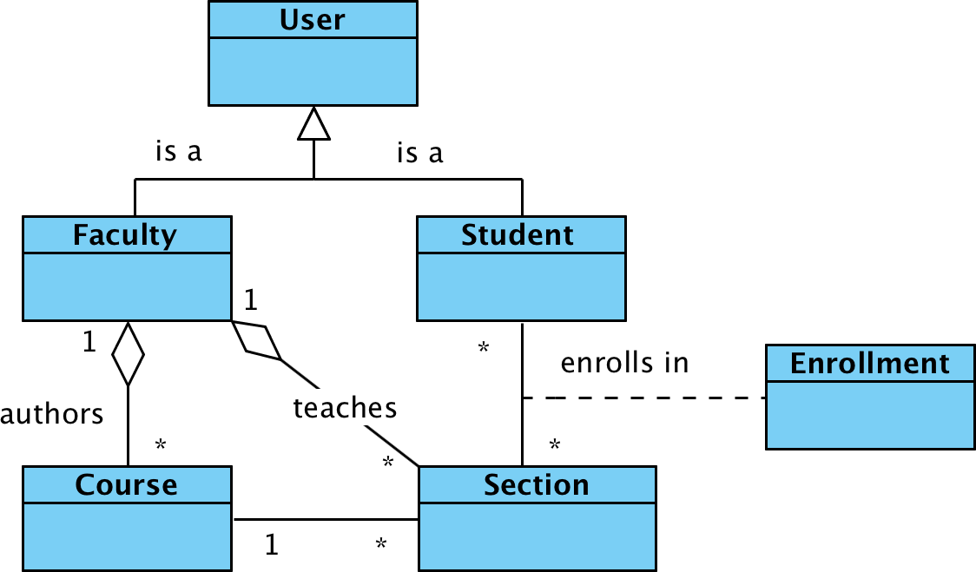

Slide 8
Java entity data models
package com.example.myapp.models;
public class User {
private String username;
private String password;
private String firstName;
private String lastName;
}
The following were left out for brevity
setters
getters
all arguments constructor
default constructor

Slide 9
Annotate models as JPA entities
import javax.persistence.*;
@Entity
public class User {
@Id
@GeneratedValue
(strategy=GenerationType.IDENTITY)
private int id;
}
JPA maps Java classes to database tables, properties to fields, and instances to records

Slide 10
Implement repository
Repositories provide API to interact with database, e.g., create, find, update, delete
package com.example.myapp.repositories;
import com.example.myapp.models.*;
import org.springframework.data.repository.*;
public interface UserRepository
extends CrudRepository<User, Integer> { }

Slide 11
Generated JPA Schema
CREATE TABLE user (
id int(11) NOT NULL AUTO_INCREMENT,
first_name varchar(255) DEFAULT NULL,
last_name varchar(255) DEFAULT NULL,
password varchar(255) DEFAULT NULL,
username varchar(255) DEFAULT NULL,
PRIMARY KEY (id)
) ENGINE=MyISAM DEFAULT CHARSET=latin1;

Slide 12
Insert some users
INSERT INTO user VALUES
('Alice','Wonderland','awonder','123');
INSERT INTO user VALUES
('Bob','Dylan','bdylan','qwe');
INSERT INTO student VALUES
('Chuck','Norris','cnorris','wer');
INSERT INTO user VALUES
('Dan','Brown','dbrown','asd');

Slide 13
TEST JPA ACCESS
Dr. Jose Annunziato

Slide 14
findAll() retrieves all records
@Autowired
UserRepository userRepository;
@Test
public void testFindAllUsers() {
List<User> users = (List<User>)
userRepository.findAll();
for(User user: users)
System.out.println(student.getFirstName());
}

Slide 15
findById() retrieves one record
@Autowired
UserRepository userRepository;
@Test
public void testFindUserById() {
User user = (User)
userRepository.findById(1).get();
System.out.println(user.getFirstName());
}

Slide 16
CUSTOM JPQL QUERIES
Dr. Jose Annunziato

Slide 17
Implementing custom queries
Declare custom queries in repository
public interface UserRepository
extends CrudRepository<User, Integer> {
public User
findUserByUsername
(String username);
}

Slide 18
Naming query parameters
Name method parameters so we can refer to them in a query
public User findUserByUsername
(@Param("username") String username);

Slide 19
Referencing query parameters
Implement query with @Query. Use JPQL or native SQL
@Query("SELECT s FROM User s
WHERE s.username=:username")
public User findUserByUsername
(@Param("username") String username);

Slide 20
Combine predicates with AND
Use AND to combine predicates
@Query("SELECT s from User s WHERE
s.username=:username AND
s.password=:=password")
public User findUserByCredentials
(@Param("username") String username,
@Param("password") String password);

Slide 21
TEST CUSTOM FINDERS
Dr. Jose Annunziato

Slide 22
Retrieve user by username
@Autowired
UserRepository userRepository;
@Test
public void testFindUserByUsername() {
User user = userRepository
.findUserByUsername("alice");
System.out.println(user.getFirstName());
}

Slide 23
Retrieve user by credentials
@Autowired
UserRepository userRepository;
@Test
public void testFindUserByCredentials() {
User user = userRepository
.findUserByCredentials("alice", "alice");
System.out.println(user.getFirstName());
}

Slide 24
SAVING DATA
Dr. Jose Annunziato

Slide 25
Creating users
@Autowired
UserRepository userRepository;
@Test
public void testCreateUser() {
User bob = new User(123, "Bob");
userRepository.save(bob);
}

Slide 26
Updating users
@Test
public void testUpdateUser() {
User bob = userRepository
.findUserByUsername("bob");
bob.setFirstName("Robert");
userRepository.save(bob);
}

Slide 27
Deleting user records
@Autowired
UserRepository userRepository;
@Test
public void testDeleteUser() {
userRepository.deleteById(5);
}

Slide 28
MODELING
INHERITANCE
Dr. Jose Annunziato

Slide 30
Faculty inherits from User
@Entity
public class Faculty extends User {
private String office;
private Boolean tenure;
}
setters
getters
all arguments constructor
default constructor

Slide 31
Single Table Inheritance Strategy (default)
CREATE TABLE user (
id int(11) NOT NULL AUTO_INCREMENT,
first_name varchar(255) DEFAULT NULL,
last_name varchar(255) DEFAULT NULL,
password varchar(255) DEFAULT NULL,
username varchar(255) DEFAULT NULL,
dtype varchar(31) NOT NULL,
office varchar(255) DEFAULT NULL,
tenure bit(1) DEFAULT NULL,
PRIMARY KEY (id)
);
Default strategy is single table inheritance. Derived class properties are denormalized to base class. dtype used to distinguish.

Slide 32
Student also inherits from User
@Entity
public class Student extends User {
private int graduationYear;
private boolean hasScholarship;
}

Slide 33
Single Table Inheritance Strategy (default)
CREATE TABLE user (
id int(11) NOT NULL AUTO_INCREMENT,
first_name varchar(255) DEFAULT NULL,
last_name varchar(255) DEFAULT NULL,
password varchar(255) DEFAULT NULL,
username varchar(255) DEFAULT NULL,
dtype varchar(31) NOT NULL,
office varchar(255) DEFAULT NULL,
tenure bit(1) DEFAULT NULL,
graduation_year int(11) DEFAULT NULL,
has_scholarship bit(1) DEFAULT NULL,
PRIMARY KEY (id)
);

Slide 34
Faculty and Student Repositories
public interface FacultyRepository extends CrudRepository<Faculty, Integer> { }
public interface StudentRepository extends CrudRepository<Student, Integer> { }

Slide 35
Insert a Faculty
INSERT INTO user
( first_name,last_name,
password,username,dtype,
office,tenure)
VALUES
( 'Tim','Birns Lee', 'tlee',
'tlee', 'Faculty','123A',1);

Slide 36
Insert Another Faculty
INSERT INTO user
( first_name,last_name,
password,username,dtype,
office,tenure)
VALUES
( 'Ada','Lovelace','alovelace',
'alovelace','Faculty','321B',1);

Slide 37
MODELING
ONE TO MANY
Dr. Jose Annunziato

Slide 39
Course Entity Data Model
@Entity
public class Course {
@Id ...
private int id;
private String title;
@ManyToOne()
private Faculty author;
}

Slide 40
One to Many Relations
@Entity
public class Faculty extends User {
private String office;
private Boolean tenure;
@OneToMany(mappedBy="author")
private List<Course> authoredCourses;
}

Slide 41
Generated JPA Course Schema
CREATE TABLE course (
id int(11) NOT NULL AUTO_INCREMENT,
title varchar(255) DEFAULT NULL,
author_id int(11) DEFAULT NULL,
PRIMARY KEY (id),
FOREIGN KEY (author_id)
REFERENCES user.id
);

Slide 42
Implementing authoredCourse()
public class Faculty extends User {
@OneToMany( mappedBy="author",
fetch = FetchType.EAGER)
private List<Course> authoredCourses;
public void authoredCourse(Course course) {
this.authoredCourses.add(course);
if(course.getAuthor() != this)
course.setAuthor(this);
}}

Slide 43
Implementing setAuthor()
public class Course {
public void setAuthor(Faculty author) {
this.author = author;
if(!author.getAuthoredCourses()
.contains(this)) {
author.getAuthoredCourses()
.add(this);
}}}

Slide 44
TESTING ONE TO MANY
Dr. Jose Annunziato

Slide 45
Testing One to Many Relations
To test one to many relation between faculty and the courses they authored, we're going to:
Create a new course
Add the course to an existing faculty
Find the faculty's authored courses
Find the course's author (inverse relation)

Slide 46
Implement a Course Repository
package com.example.myapp.repositories;
import org.springframework.data.repository.*;
import com.example.myapp.models.*;
public interface CourseRepository extends
CrudRepository<Course, Integer> {}

Slide 47
Test Create Course
public class TestCourses {
@Autowired
CourseRepository courseRepository;
@Test
public void testCreateCourse() {
Course course = new Course();
course.setTitle("CS5200");
courseRepository.save(course);
}}

Slide 48
FacultyService.authoredCourse()
public void testAuthoredCourse() {
Faculty faculty = facultyRepository.findById(1).get();
Course course = courseRepository.findById(2).get();
course.setAuthor(faculty);
courseRepository.save(course);
faculty.authoredCourse(course);
facultyRepository.save(faculty);
}
⇐
use either or both
⇐

Slide 49
Find Authored Courses
public void testFindAuthoredCourses() {
Faculty faculty = facultyRepository.findById(1).get();
List<Course> courses = faculty
.getAuthoredCourses();
for(Course course:courses) {
System.out.println(course.getTitle());
}
}

Slide 50
Find a Course Author
public void testFindCourseAuthor() {
Course course = courseRepository
.findById(1).get();
Faculty faculty = course.getAuthor();
System.out.println(faculty.getFirstName());
}

Slide 51
MANY TO MANY
Dr. Jose Annunziato

Slide 53
Implement Section Data Model
@Entity
public class Section {
@Id
@GeneratedValue(strategy=GenerationType.IDENTITY)
private int id;
private String title;
@ManyToMany(mappedBy="enrolledSections")
private List<Student> enrolledStudents;
}

Slide 54
Add Bi-Directional Relation
@Entity
public class Student extends User {
@ManyToMany
@JoinTable(name="ENROLLMENT",
joinColumns=@JoinColumn(name="STUDENT_ID",
referencedColumnName="ID"),
inverseJoinColumns=@JoinColumn(name=
"SECTION_ID", referencedColumnName="ID"))
private List<Section> enrolledSections;
}

Slide 55
ENROLLMENT table
CREATE TABLE enrollments (
student_id int(11) NOT NULL,
section_id int(11) NOT NULL,
FOREIGN KEY (section_id)
REFERENCES section (id),
FOREIGN KEY (student_id)
REFERENCES user (id)
);

Slide 56
CREATE NEW SECTIONS
Dr. Jose Annunziato

Slide 57
Implement Section Repository
public interface SectionRepository extends
CrudRepository<Section, Integer> { }

Slide 58
Insert Some Sections
INSERT INTO section (title)
VALUES ('SECTION01');
INSERT INTO section (title)
VALUES ('SECTION02');

Slide 59
Test find all sections
@Test
public void testFindAllSections() {
List<Section> sections = (List<Section>)
sectionRepository.findAll();
for(Section section : sections) {
System.out.println(section.getTitle());
}
}

Slide 60
ENROLL STUDENTS IN SECTIONS
Dr. Jose Annunziato

Slide 61
Section.enrollStudent()
@ManyToMany(mappedBy="enrolledSections")
private List<Student> enrolledStudents;
public void enrollStudent(Student student) {
this.enrolledStudents.add(student);
if(!student.getEnrolledSections().contains(this)) {
student.getEnrolledSections().add(this);
}
}

Slide 62
Student.enrollSection()
private List<Section> enrolledSections;
public void enrollSection(Section section) {
this.enrolledSections.add(section);
if(!section.getEnrolledStudents().contains(this))
section.getEnrolledStudents().add(this);
}

Slide 63
SectionService.enrollStudentInSection()
@Autowired
SectionRepository sectionRepository;
@Autowired
StudentRepository studentRepository;
@Test
public void testEnrollStudentInSection() {
Section section = sectionRepository.findById(1).get();
Student student = studentRepository.findById(3).get();
student.enrollSection(section); ⇐ always add on join table
studentRepository.save(student);
}

Slide 64
StudentService.enrollStudentInSection()
@Autowired
SectionRepository sectionRepository;
@Autowired
StudentRepository studentRepository;
@Test
public void testEnrollSectionForStudent() {
Section section = sectionRepository.findById(2).get();
Student student = studentRepository.findById(3).get();
student.enrollSection(section);
studentRepository.save(student);
}

Slide 65
Query STUDENT_SECTION
SELECT * FROM course-manager.student_section;
student_id section_id
-----------------------
6 2
5 1

Slide 66
RETRIEVING ENROLLMENTS
Dr. Jose Annunziato

Slide 67
Retrieve Student Enrollments
public class StudentService {
@GetMapping("/api/students/{sId}/sections")
public Iterable<Section>
findStudentEnrolledSections(
@PathVariable("sId") int sId) {
Student student =
studentRepository.findOne(sId);
return student.getEnrolledSections();
}}

Slide 68
Retrieve Section Enrollments
public class SectionService {
@GetMapping("/api/sections/{sId}/students")
public Iterable<Student>
findSectionEnrolledStudents(
@PathVariable("sId") int sId) {
Section section =
sectionRepository.findOne(sId);
return section.getEnrolledStudents();
}}

